Slide 1


Prediction 1
Huong (Valerie) Le

Slide 2

Method
I used function chisq() to compare each variable column with the predicted column (Hired)
From the result of chisq function, I then eliminated the ones that failed to be independent from column of prediction (Hired), as there is a very low chance this will affect our prediction.
Using table() function to sliced the data in multiple ways, I obtained the number of people who get hired or not
Finally, I categorized whether students get hired by which range they fell under

Slide 3




Chi-squared
Here, we can see both p-value is less than 0.05 (critical value)
Hence, we reject the alternative hypotheses- Candidates’ coding and first impression are independent of whether they get hired or not

Slide 4




Chi-squared (2)
Because p-value of H03 is greater than 0.05, we accept the null hypothesis. Hence, major is independent on whether candidates get hired or not
Major will less likely be the predictor for getting hired!
Since p-value of H04 is less than 0.05, we reject the null hypothesis. College is dependent on whether candidates get hired or not

Slide 5
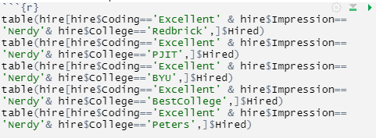


Distribution of Hiring by Nerdy Candidates with Excellent coding skills
Here, we can see that all of the candidates are most likely get hired
I will assign Hired purely using the number of ‘No’ and ‘Yes’

Slide 6
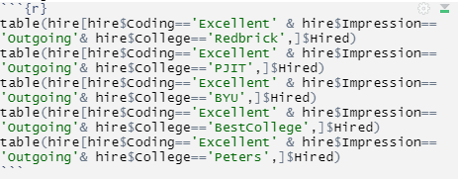

Distribution of Hiring by Outgoing Candidates with Excellent coding skills
Here, we can see that all of the candidates are most likely get hired
I will assign Hired purely using the number of ‘No’ and ‘Yes’

Slide 7

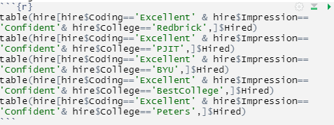
Distribution of Hiring by Confident Candidates with Excellent coding skills
Here, we can see that all of candidates are most likely get hired
I will assign Hired purely using the number of ‘No’ and ‘Yes’

Slide 8

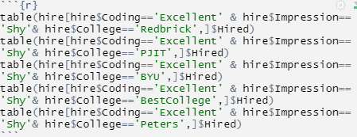
Distribution of Hiring by Shy Candidates with Excellent coding skills
Here, we can see that all of candidates are most likely get hired
I will assign Hired purely using the number of ‘No’ and ‘Yes’

Slide 9

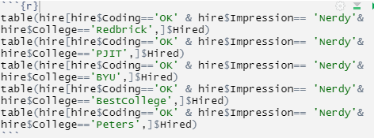
Distribution of Hiring by Nerdy Candidates with OK coding skills
Here, we can see that all candidates are most likely get hired EXCEPT for candidates from Best College with 100% chance of being rejected
I will assign Hired purely using the number of ‘No’ and ‘Yes’

Slide 10

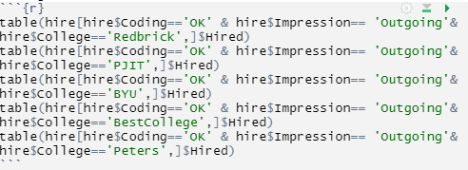
Distribution of Hiring by Outgoing Candidates with OK coding skills
Here, we can see that all candidates are most likely get hired
I will assign Hired purely using the number of ‘No’ and ‘Yes’

Slide 11

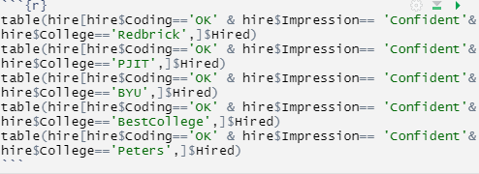
Distribution of Hiring by Confident Candidates with OK coding skills
Here, we can see that all candidates are most likely get hired
I will assign Hired purely using the number of ‘No’ and ‘Yes’

Slide 12

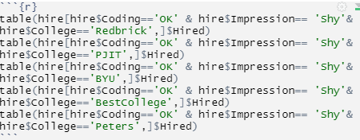
Distribution of Hiring by Shy Candidates with OK coding skills
Here, we can see that all candidates are most likely get hired EXCEPT for candidates from Best College with 100% chance of getting REJECTED.
I will assign Hired purely using the number of ‘No’ and ‘Yes’

Slide 13

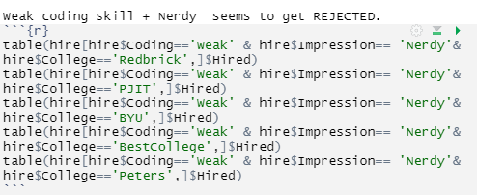
Distribution of Hiring by Nerdy Candidates with Weak coding skills
Here, we can see that all candidates are most likely get rejected except for candidates from Redbrick!
I will assign Hired purely using the number of ‘No’ and ‘Yes’

Slide 14
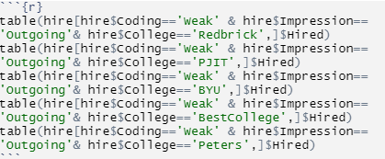

Distribution of Hiring by Outgoing Candidates with Weak coding skills
Here, we can see that all candidates are most likely get rejected
I will assign Hired purely using the number of ‘No’ and ‘Yes’

Slide 15
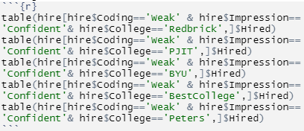

Distribution of Hiring by Confident Candidates with Weak coding skills
Here, we can see that all candidates are most likely get rejected
I will assign Hired purely using the number of ‘No’ and ‘Yes’

Slide 16

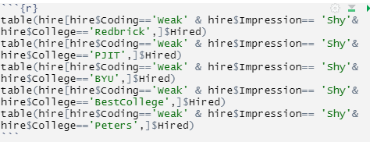
Distribution of Hiring by Shy Candidates with Weak coding skills
Here, we can see that all candidates are most likely get rejected
I will assign Hired purely using the number of ‘No’ and ‘Yes’

Slide 17
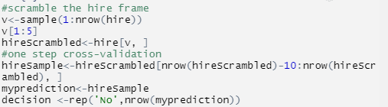





Cross-Validation
To find this, I had to rename variables <hire$Hired> vector into <decision> and the <test> data frame into <prediction>

Slide 18
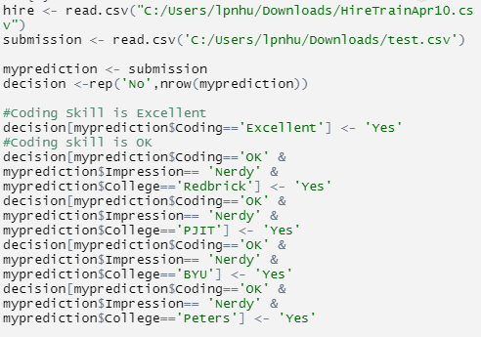
All codes for submission to Kaggle

Slide 19
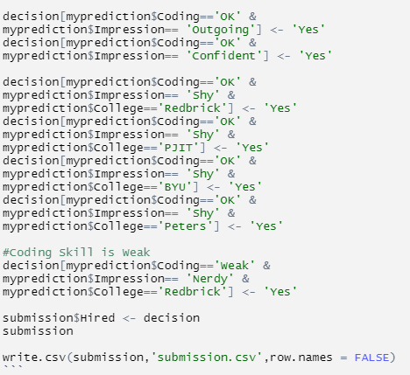
All codes for submission to Kaggle

Slide 20
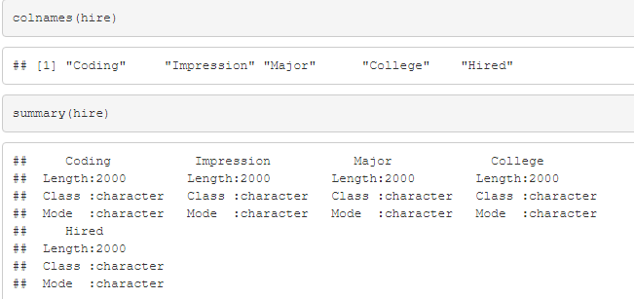
Additionally- Getting to know your data

Slide 21
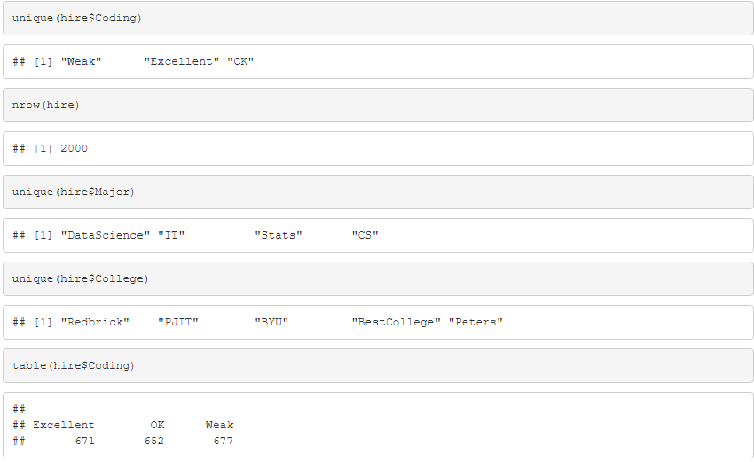
Additionally- Getting to know your data (2)

Slide 22
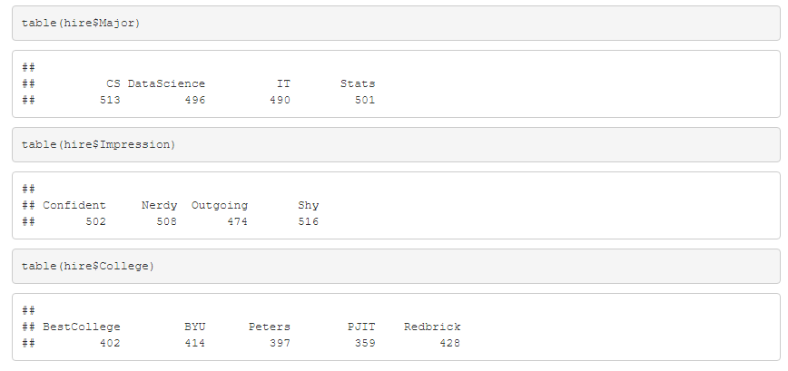
Additionally- Getting to know your data (3)

Slide 23
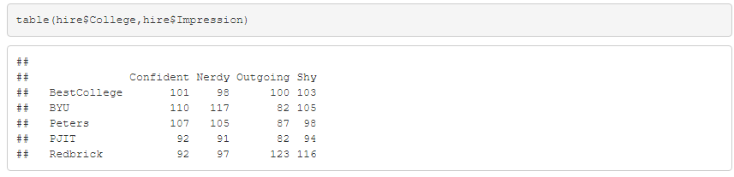
Additionally- Did you know that candidates who comes from RedBrick are more outgoing than candidates from other schools?

Slide 24
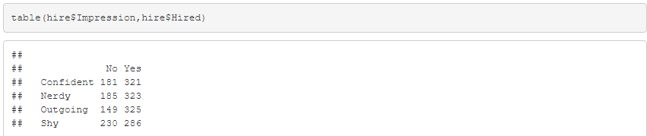
Additionally- Did you know that candidates who are confident have ~64% chance of getting hired?

Slide 25
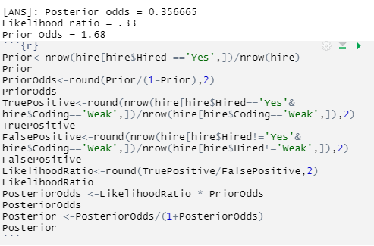
Additionally- Bayesian
What are the posterior odds that students who have weak coding skills get hired?

